Slide 1
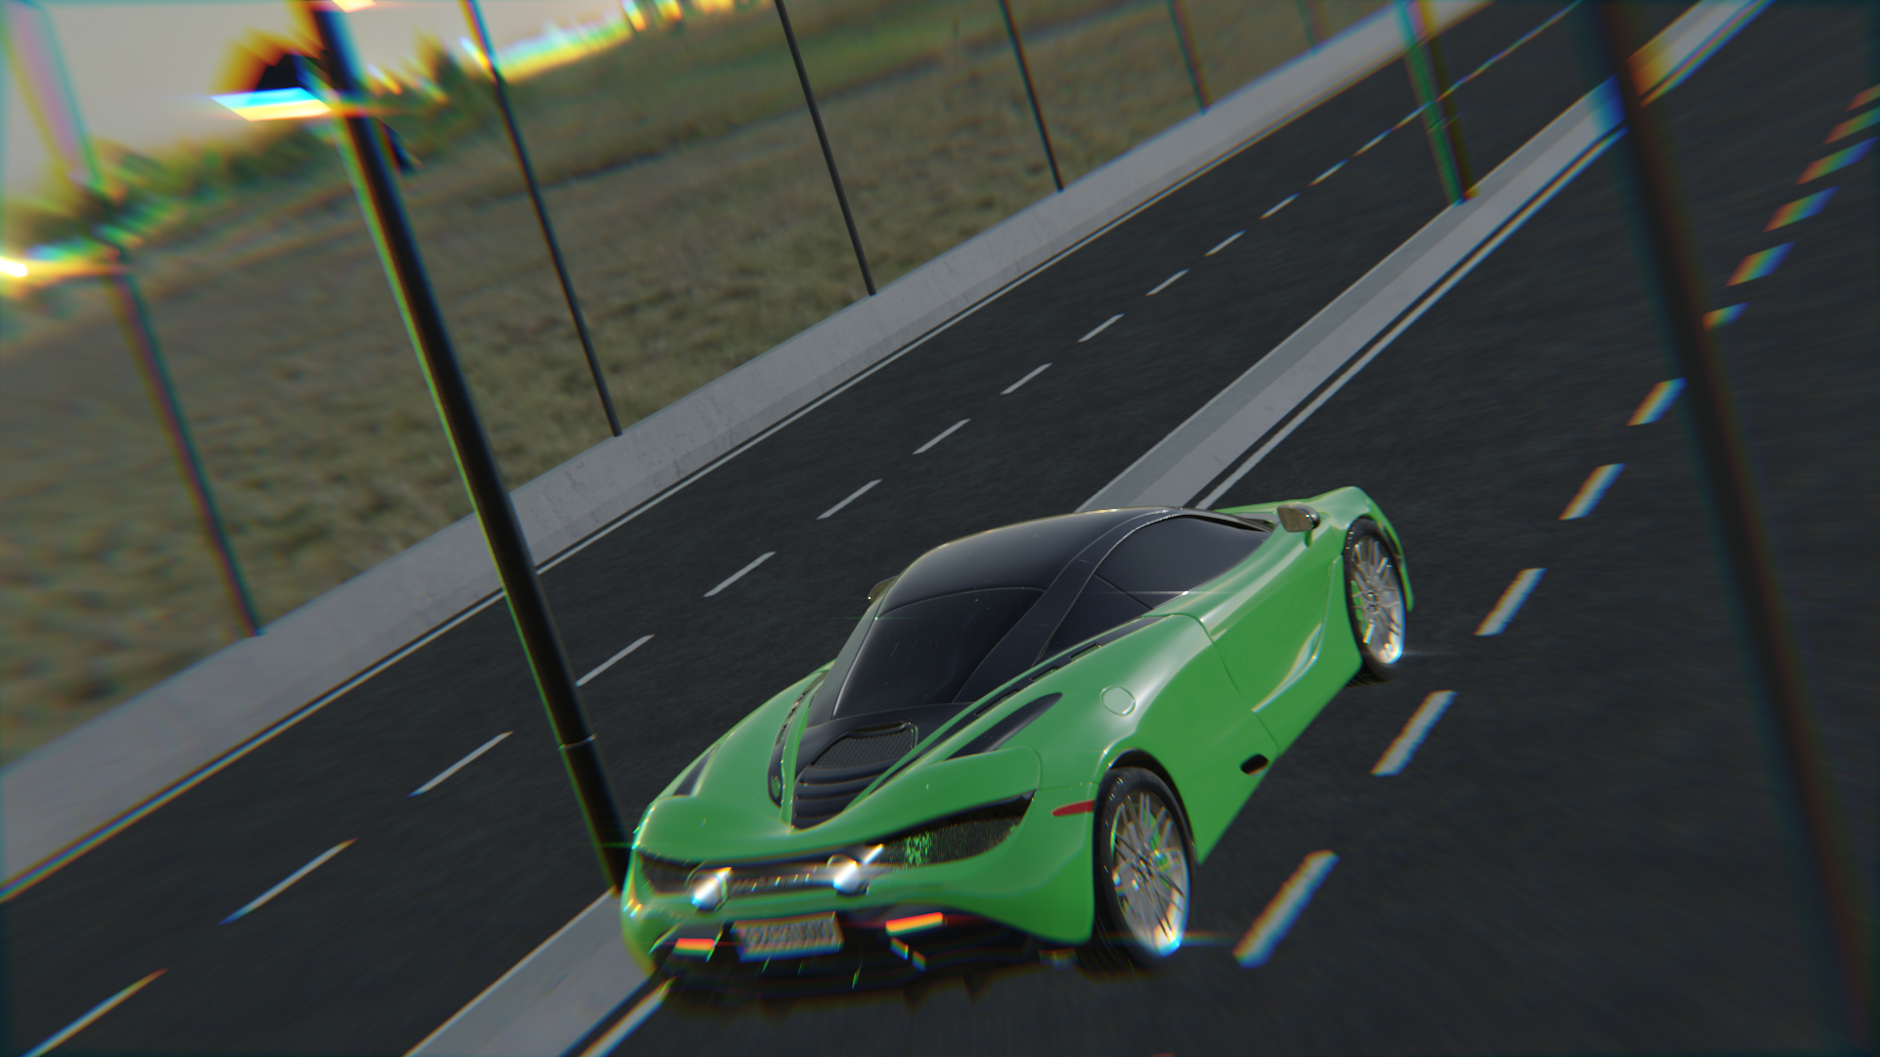
3D Car Animation Video using Blender
PRESENTED BY :
NAME: NITA CHAND
STUDENT ID: 2024100
PRESENTED TO: Prof. Grace Kennedy

Slide 2
Contents
Introduction
Used Tools
Wireframe
Solid view
Rendered view
Output

Slide 3
Introduction
3D animation video
Using 3d car and bridge
Having environment texture by using poly heaven tool
Adjusting the angle of camera to show the different view

Slide 4
Used tools
Polyheaven:
It is used to make environment texture
Can have different texture for bckground
Blender toolkit:
Used to create – bridge, car and street light
Having multiple options for 3d objects

Slide 5
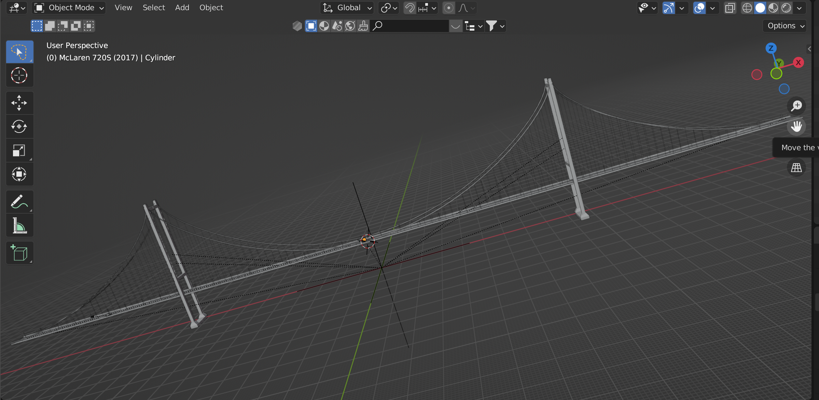
Solid View of Bridge

Slide 6
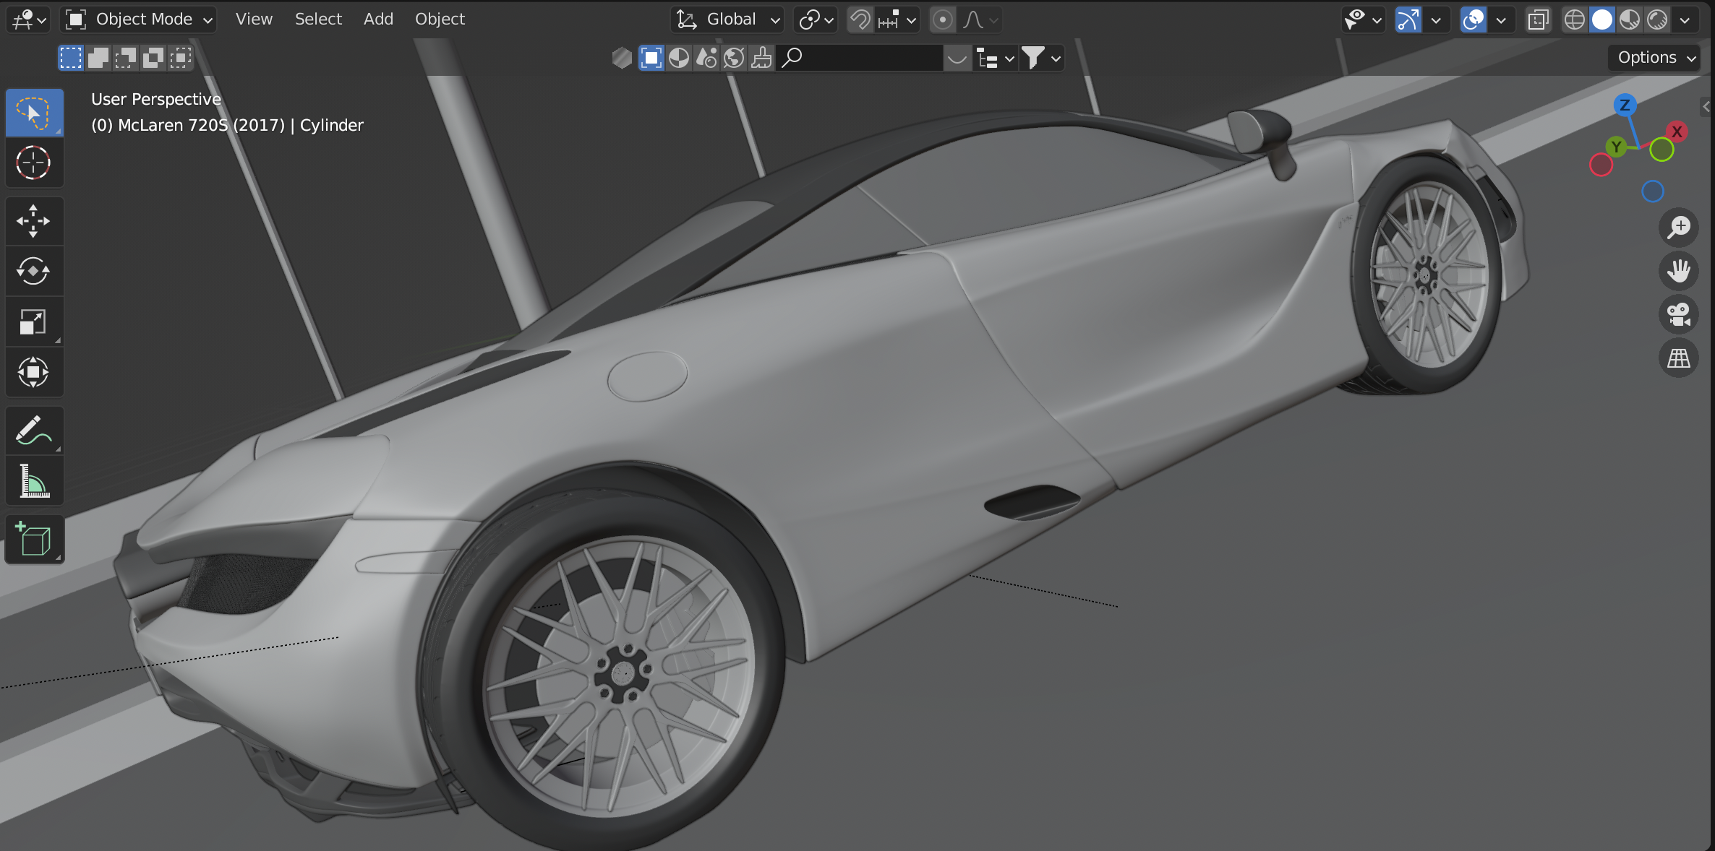
Solid view of car

Slide 7
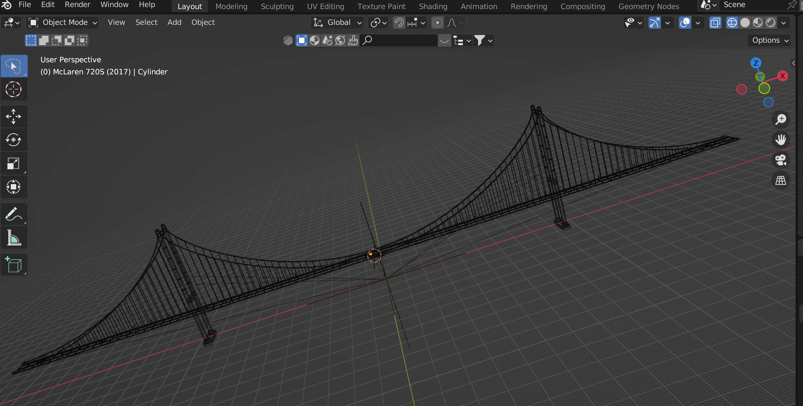
Wireframe of bridge

Slide 8
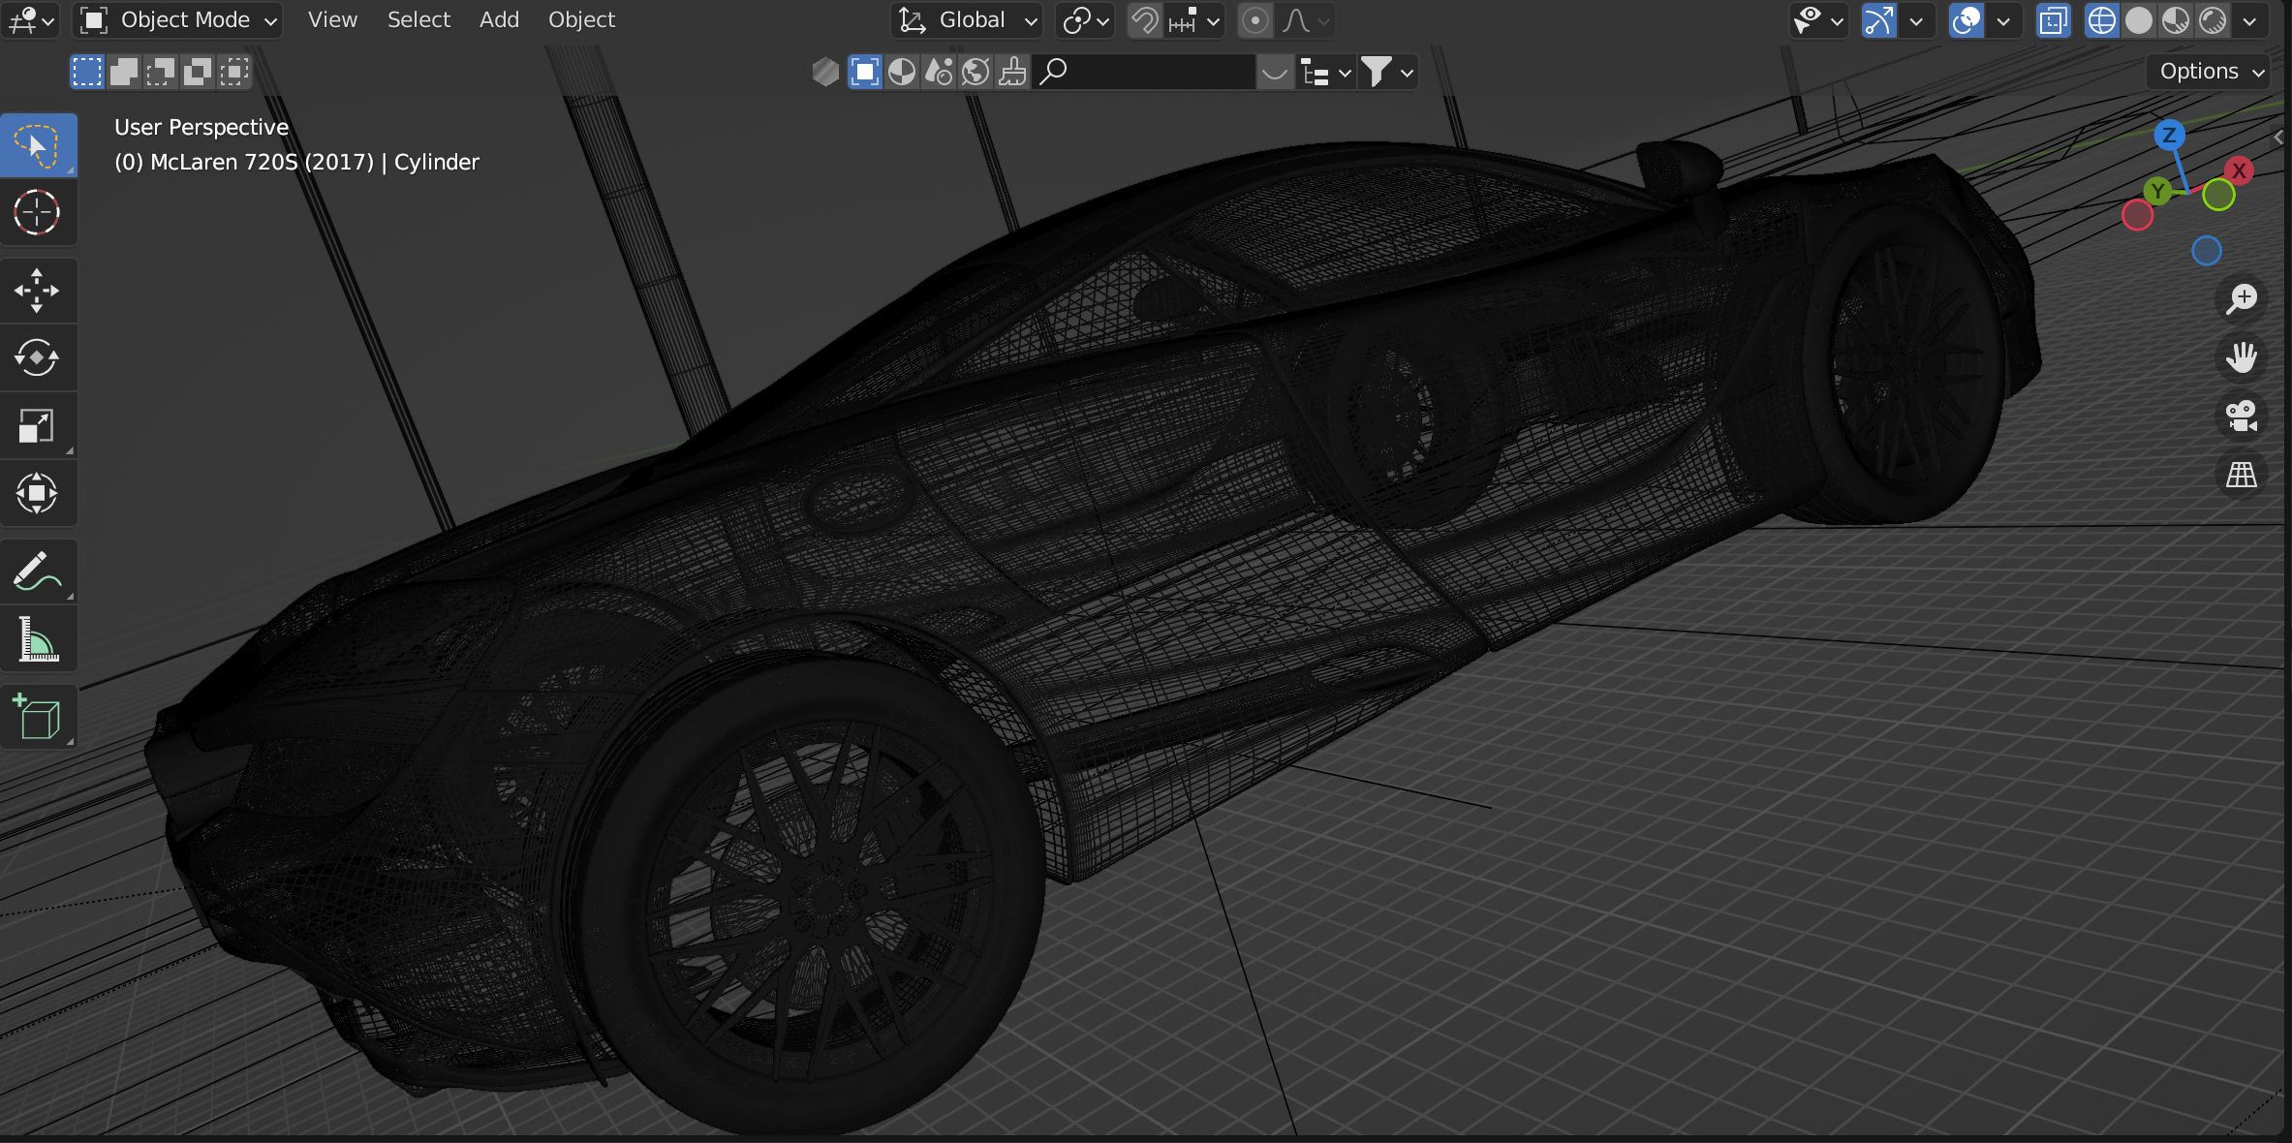
Wireframe of Car

Slide 9
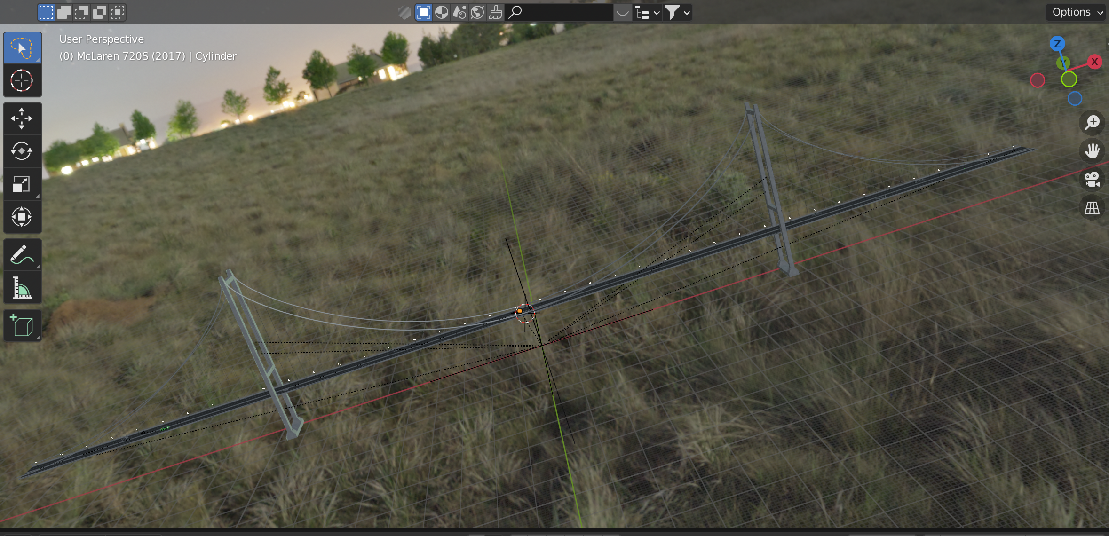
Rendered image of bridge

Slide 10
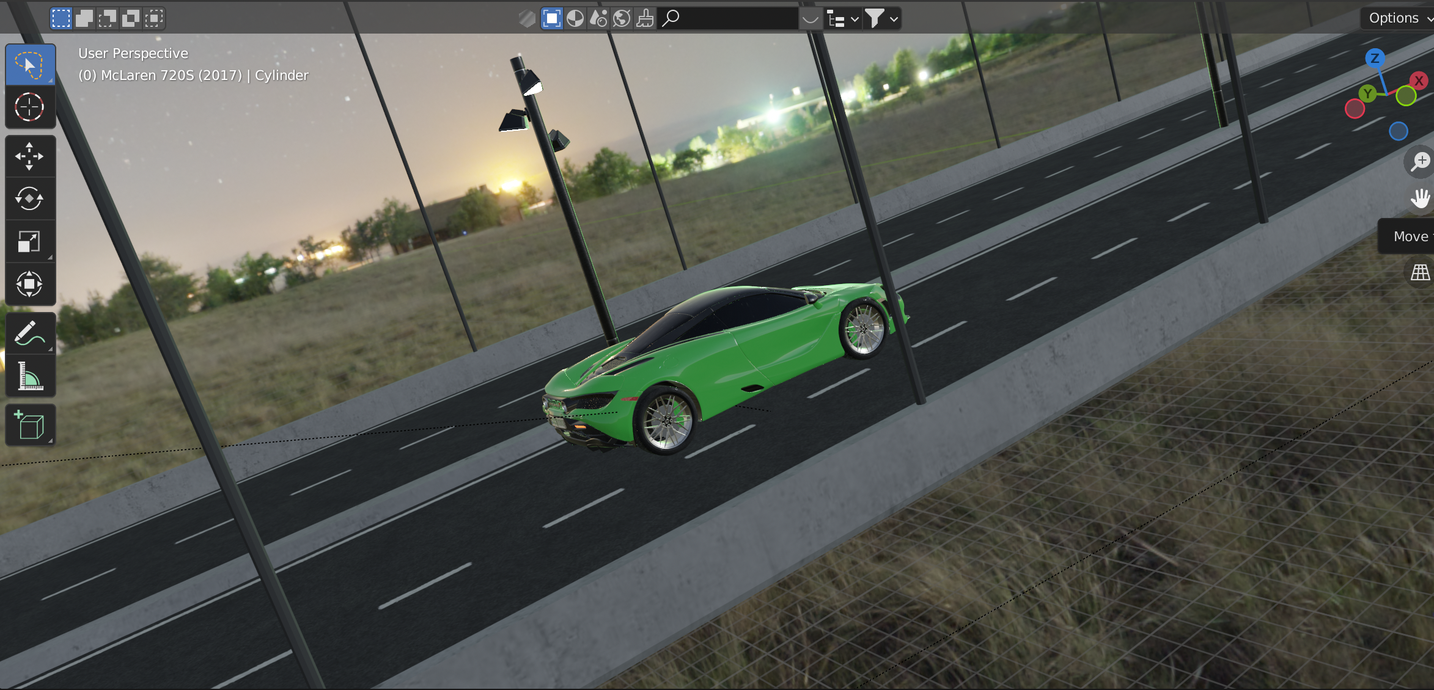
Rendered image of car

Slide 11
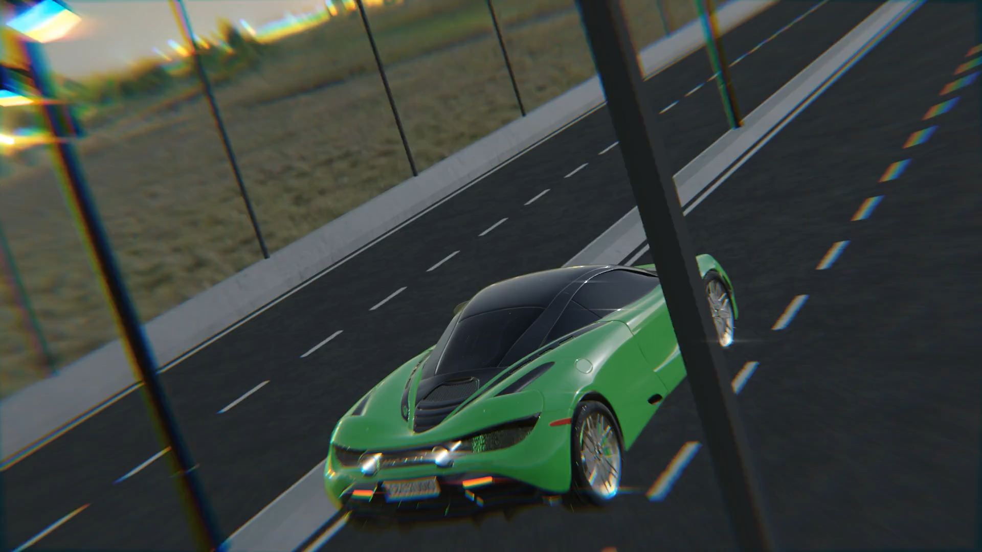
Output

Slide 12
THANK YOU….

